Slide 1

PANORAMA STEREO reconstruction
PRESENTERS: Arjun Umashankar, harini hariharakrishnan, Kushal Mahalingaiah instructor: Dr. Anup basu mm805 computer vision and 3dtv

Slide 2

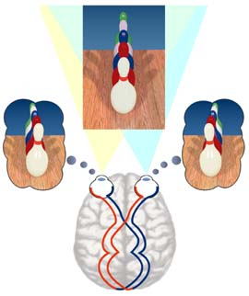
STEREO VISION
Fusing two views of the same subject with depth perception
Combine two images using similarity match and difference addition to give a 3D stereo picture
Visualizing solid objects in three spatial dimensions – width, height and depth
Relating objects to our position especially in the depth dimension.

Slide 3
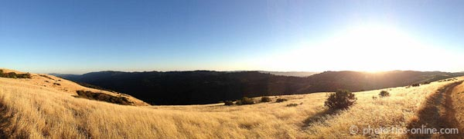
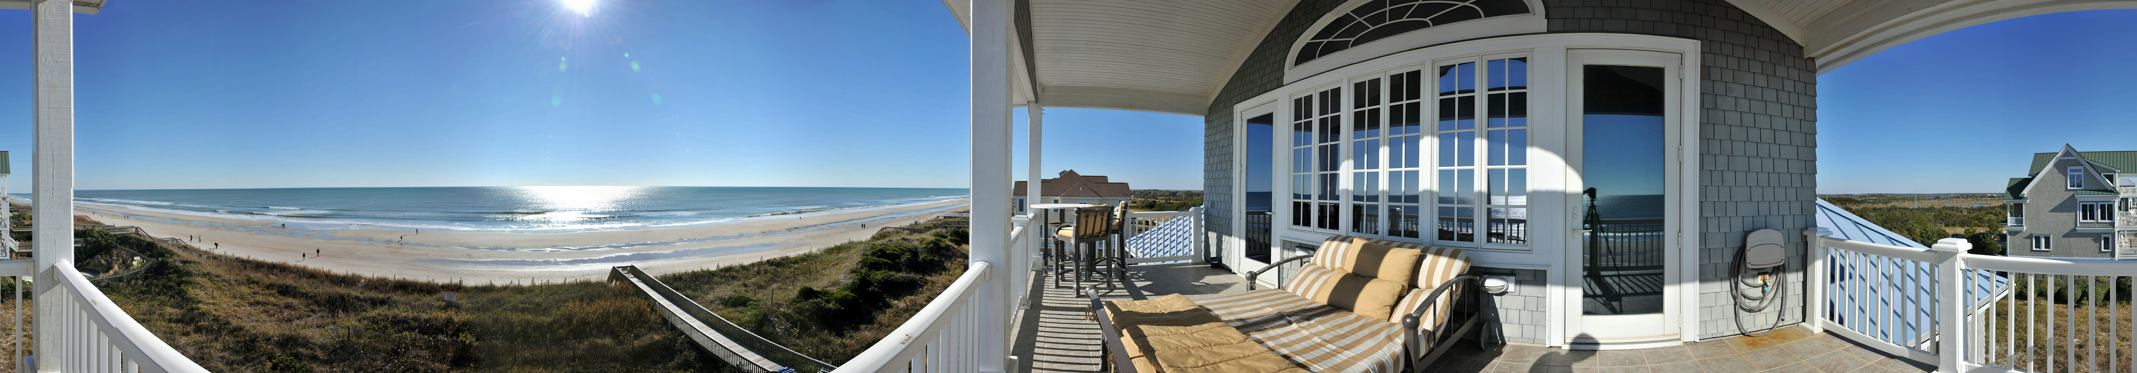
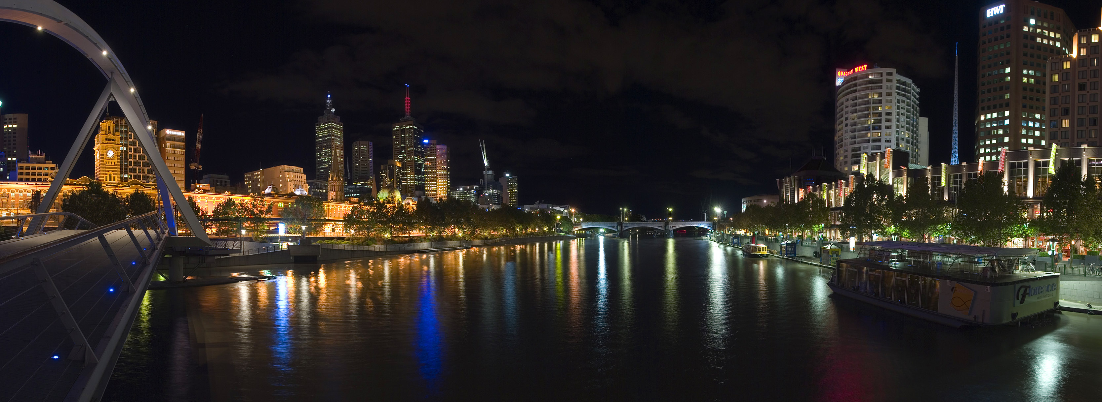
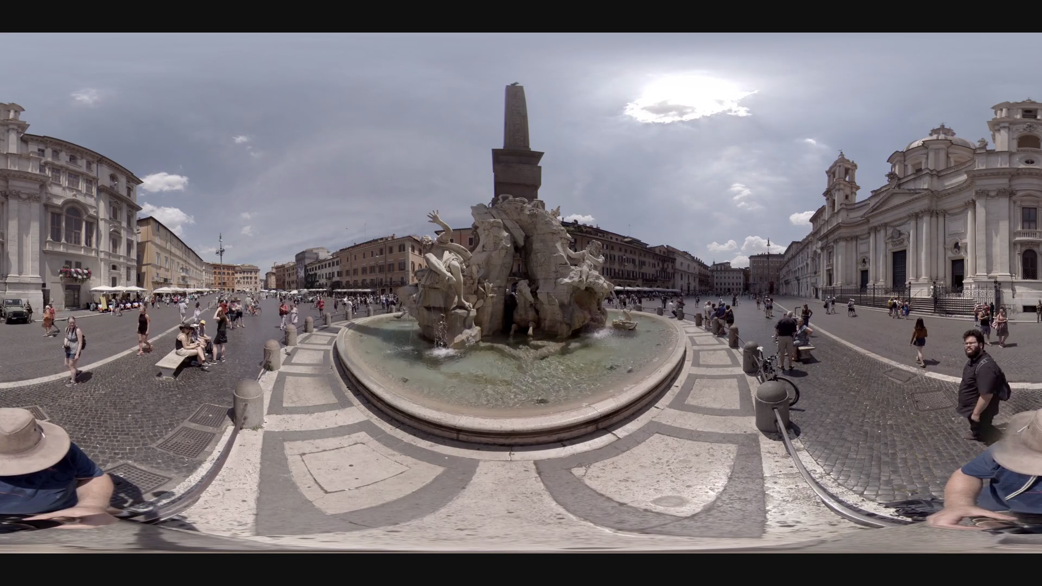
PANORAMA
Unobstructed and wide view of an extensive area.
Images that have wider field of view.
Not restricted to horizontal axis.

Slide 4
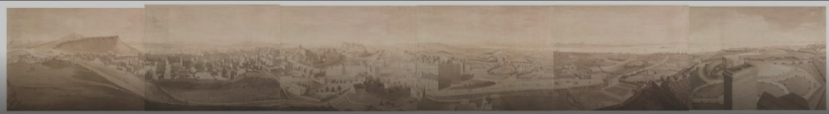
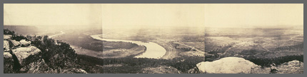
PANORAMA
Robert Barker, early 19th century, painted over a cylinder of 10m*40m specs. "The Panorama“ - 360° view
George Barnard, late 19th built panorama from multiple images from static cameras.
Union Army for Civil War to get overviews of terrain and fortifications.

Slide 5
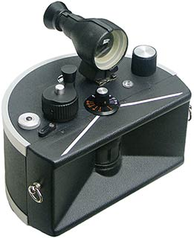
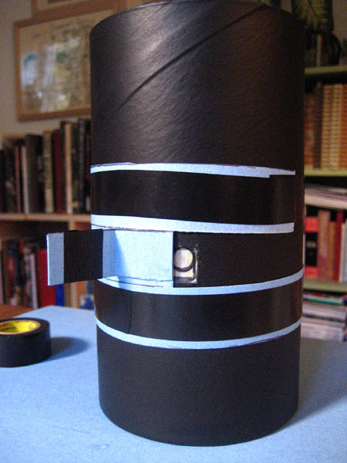
PANORAMA
Swing-lens camera were used to take co-related images.
After the advent of pin-hole camera, "oatmeal box" design was introduced, generated 180° view.
1970 and 1980, “Multi-image slide” from adjacent pinhole cameras used overlap.
Late twentieth century, automated assembly using “image stitching” of Panoscan images.
Control angle and disparity
Uses tri-linear CCD (charge-coupled device) array.
Tri-linear is 3 copies of same image over different exposures and use template, feature mapping for stitching.
Having 3 copies over 1 results in less error in stitching.

Slide 6

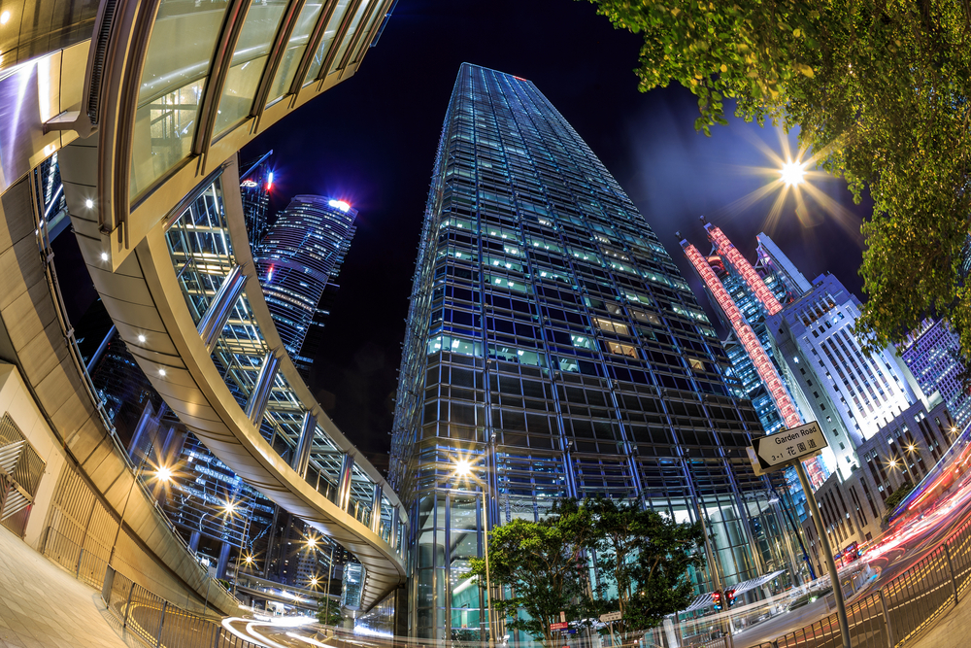
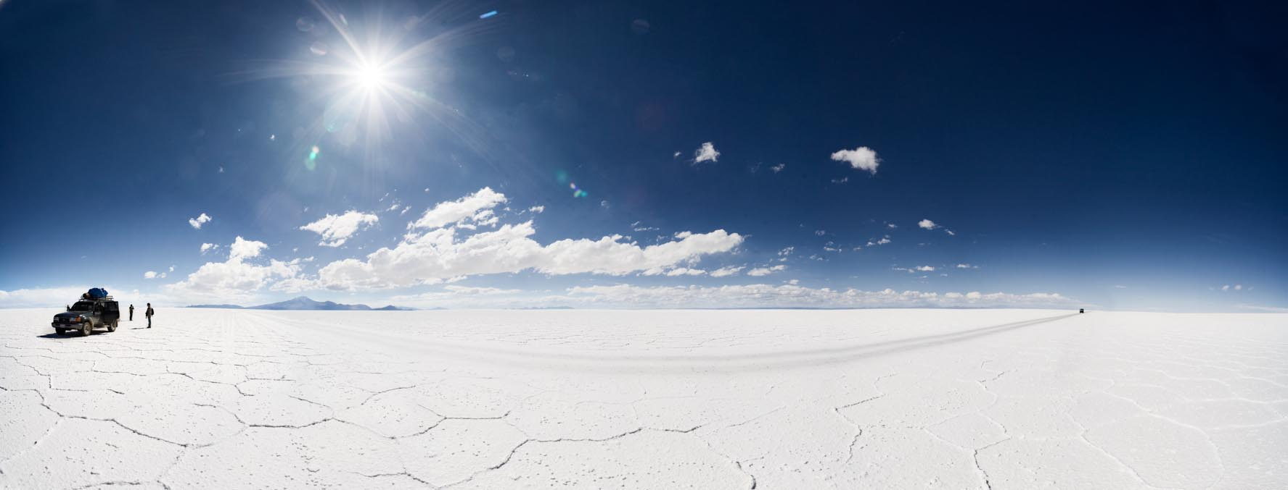
PANORAMA vs wide-lens photo

Slide 7
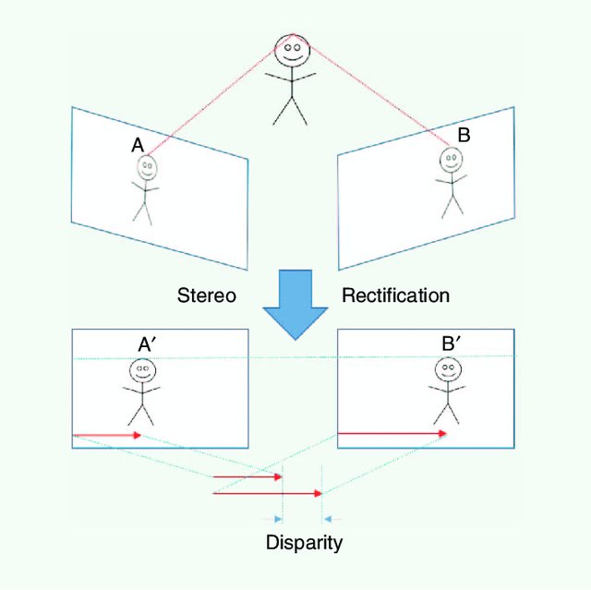
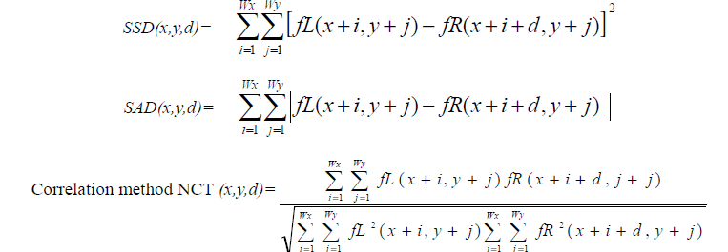
Stereo matching
Disparity – stereo correspondence to determine three dimensional depth using pair of left and right images from stereo vision system
SSD (Sum of Square Differences), SAD (Sum of Absolute Differences) or normalized correlation techniques (NCT) used to matching windows of pixels for disparity.

Slide 8
Stereo matching algorithms
Dense Disparity Algorithms (local methods) – Area based stereo matching, Sum of Absolute Difference (SAD) technique, Shape based Stereo Matching, Cellular Automata (CA)
Color Segmentation based Algorithms (global methods) – Intensity or energy based stereo matching, Dense Stereo using pivoted programming, Layered Stereo matching, Contrast Invariant Stereo Correspondence, Hierarchical Belief Propagation
Spiral Methods – Spiral Searching Algorithm
Continuous Wavelet Transform (CWT), Non Uniform Rational B-splines (NURBS), Neural Adaptive Stereo Matching

Slide 9
PANORAMA IMAGE (360⁰ View)

Slide 10
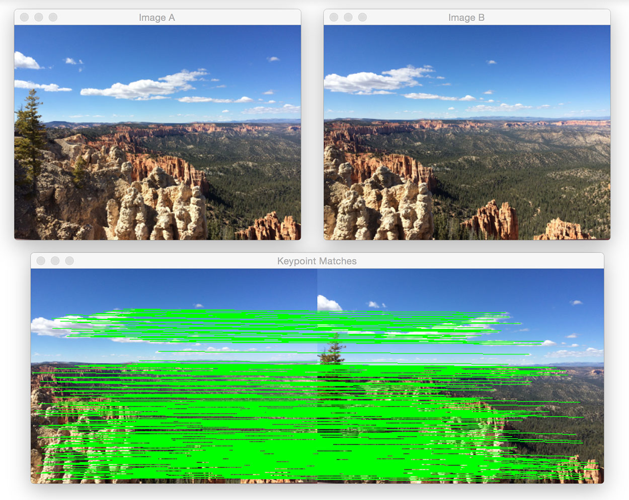
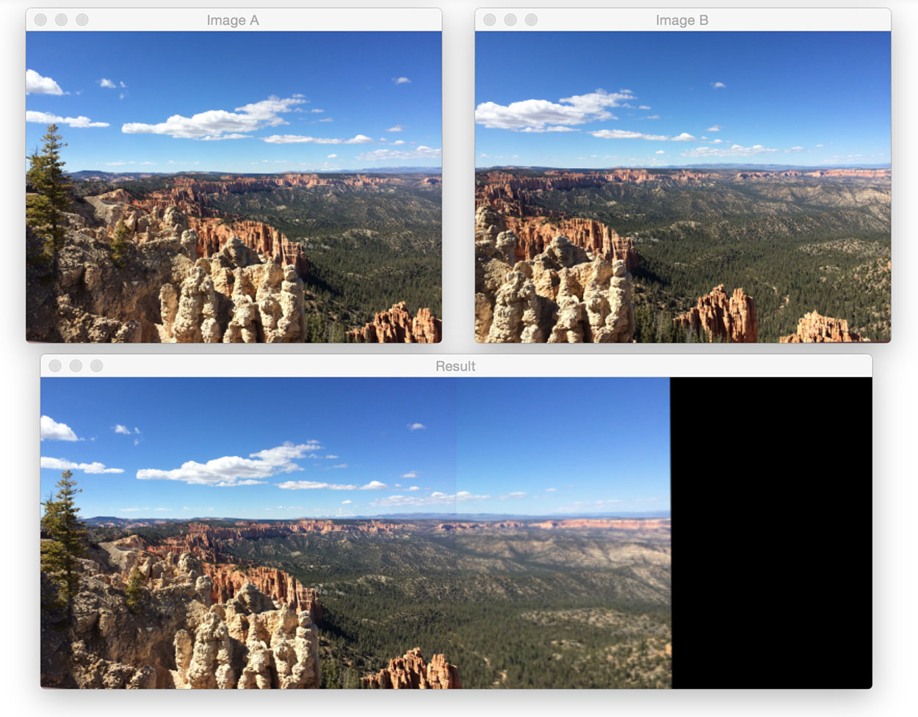
Panorama stereovision reconstruction (IMAGE STITCHING)
Reconstruction is the task of finding a 3D scene point from a set of image points
Panorama stitching algorithm using OpenCV:
Step #1: Detect keypoints (DoG, Harris, etc.) and extract local invariant descriptors (SIFT, SURF, etc.) from the two input images.
Step #2: Match the descriptors between the two images
Step #3: Use the RANSAC algorithm to estimate a homography matrix using our matched feature vectors.
Step #4: Apply a warping transformation using the homography matrix obtained from Step #3.

Slide 11

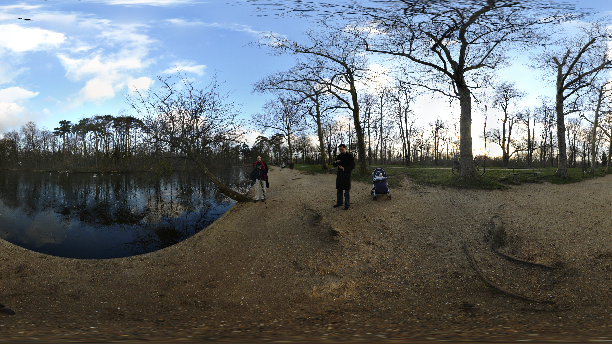
hugin
Open source Panorama stitcher with a GUI and support for various output projections including a range of spherical, cartographic, and camera projections.
Algorithm steps:
If the graph is directed then moralize it to make it un-directed.
Introduce the evidence.
Triangulate the graph to make it chordal.
Construct a junction tree from the triangulated graph
Propagate the probabilities along the junction tree (via belief propagation)

Slide 12
Autostitch (Automatic Panoramic Image Stitching using Invariant Features)
Input: n unordered images
I. Extract SIFT features from all n images
II. Find k nearest-neighbours for each feature using a k-d tree
III. For each image:
(i) Select m candidate matching images that have the most feature matches to this image
(ii) Find geometrically consistent feature matches using RANSAC to solve for the homography between pairs of images
(iii) Verify image matches using a probabilistic model
IV. Find connected components of image matches
V. For each connected component:
Output: Panoramic image(s)
(i) Perform bundle adjustment to solve for the rotation ϴ1, ϴ2, ϴ3 and focal length f of all cameras
(ii) Render panorama using multi-band blending

Slide 13
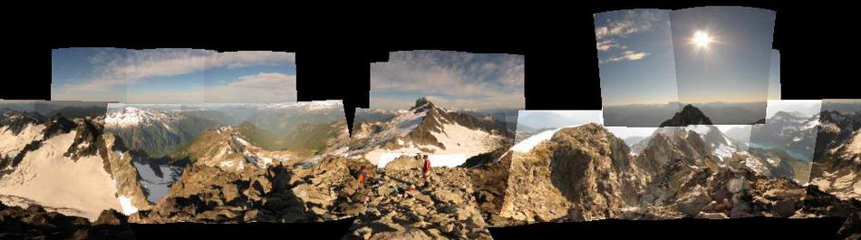
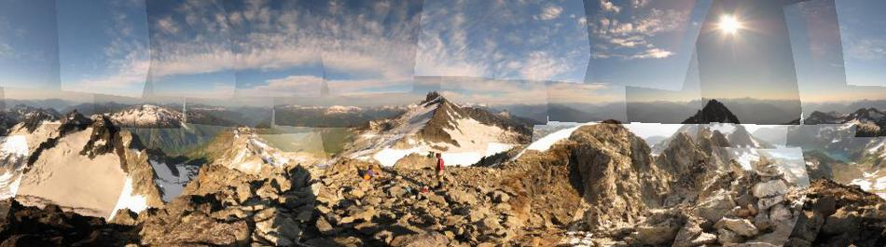
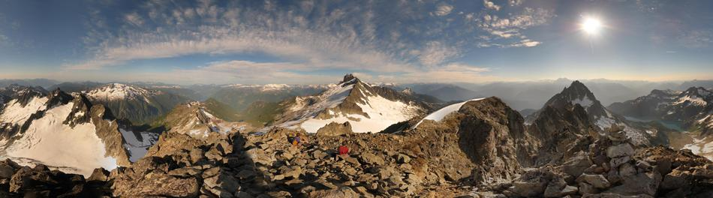
AutoStitch (contd.)

Slide 14
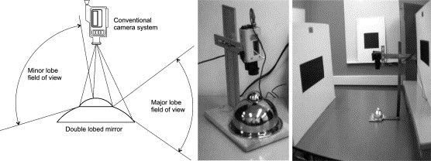
Omni directional stereo vision
Omni-directional sensors used to obtain 360⁰ field of view with a single lens camera, constructed using a single camera and a mirror consisting of two concentric, radially symmetric lobes.
Concentric double convex lobes each provide an image covering the complete azimuth image, but each over a limited range of elevations. The overlapped elevation range visible to both lobes is the stereo field of the device.
An object is imaged from two different positions in space, in both lobes, giving depth information.
Crucial to address design issues like Vertical extent of stereo fov, orientation of eye separation.

Slide 15
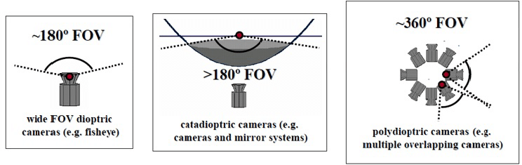
Dioptric vs Catadioptric VS POLYDIOPTRIC cameras
Dioptric cameras use a combination of shaped lenses and can reach a field of view even bigger than 180 degrees (only lenses used)
Catadioptric cameras combine a standard camera with a shaped mirror — such as a parabolic, hyperbolic, or elliptical mirror — and provide 360-degree field of view in the horizontal plane and more than 100 degrees in elevation (lenses and mirrors are used)
Polydioptric cameras use multiple cameras with overlapping field of view and so far are the only cameras that provide a real omnidirectional (spherical) field of view.

Slide 16
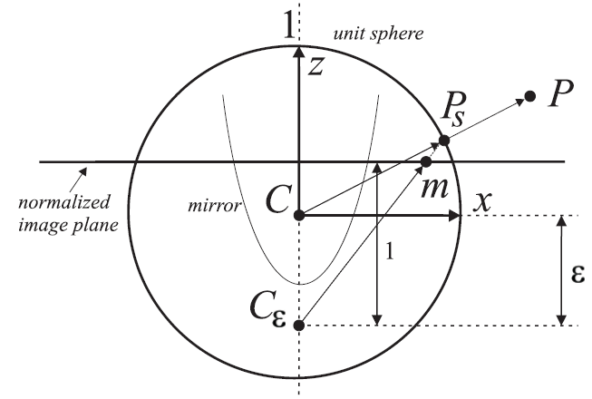
Unified model for central catadioptric cameras
Catadioptric (parabolic, hyperbolic, elliptical) and standard perspective projection is equivalent to a projective mapping from a sphere, centered in the single viewpoint, to a plane with the projection center on the perpendicular to the plane and distant ε from the center of the sphere.
P = (x, y, z) be a scene point in the mirror reference frame centered in C
x and y axes of the camera and mirror are aligned, and the camera and mirror reference frames differ only by a translation along z.
Projecting the scene point onto the unit sphere: Ps = P/||P|| = (x_{s}, y_{s}, z_{s})
Point coordinates are then changed to a new reference frame centered in C_{ε} = (0, 0, −ε): P_{ε} = (x_{s}, y_{s}, z_{s} + ε).
P _{ε} is then projected onto the normalized image plane distant 1 from C_{ε} m˜ = (x_{m}, y_{m}, 1) = (x_{s}/z_{s} + ε, y_{s}/z_{s} + ε, 1 ) = g⁻¹ (P_{s}).
point m˜ is mapped to the camera image point p˜ = (u, v, 1) through the intrinsic-parameter matrix K: p˜ = K m˜

Slide 17
Single View Point criteria (SVP)
SVP cameras are basically Central Catadioptric systems.
Single View-Point criteria for an imaging system permits the detection of the projection of straight lines in a scene.
SVP camera model with radial distortion correction and focal length adjustment can compensate for refraction and achieve high accuracy.
Two general approaches that can be used to find the projection of straight line edges in the scene:
The captured image can be warped to provide several equivalent perspective views in different directions using Hough Transform for straight lines
Use geometric properties to find straight line projections directly in the source image.

Slide 18
Non svp (single view point criteria)
Vertically oriented catadioptric optical system that employs a mirror with a radial profile other than parabolic or hyperbolic - Cannot maintain the straightness of non-vertical lines.
Non-parabolic or hyperbolic mirror profiles are desirable for resolution distribution, sensor size, and cost - Non-central or Non-single view-point (SVP).
Man made environment systems and robots; Since straight line edges are a salient feature detection.
Non-SVP profiles include spherical mirrors.
Applications: Factory or warehouse robots, courier or cleaning robots in an office environment.

Slide 19
Polyhedral world reconstruction
To model indoor spaces with special double-lobed single-image plane sensor.
The primitives correspond to horizontal and vertical polygon boundaries; extracts and tracks feature primitives
Goal can be achieved with the bi-lobed mirror design, the projections of horizontal and vertical line segments are found in each of the mirror lobes, and the resultant feature set matched and reconstructed in three dimensions.
Feature Extraction: The Panoramic Hough Transform and the Identify and Remove algorithms feature detection stages.
Recovery of straight lines in non-SVP panoramic system:
The only straight lines in the scene that project onto straight lines in the image are those parallel to the main axis - panoramic catadioptric image sensor.
If the axis is vertical, then only vertical lines will be captured as straight lines in the image.
A horizontal straight line edge projects to a complex curve in the image, depending on the radial profile.
If the mirror profile is hyperbolic or parabolic, this curve will be a conic section. For the general non-SVP case this projection is curved, but not circular. For a spherical mirror (circular mirror profile), the projection cannot be uniquely defined.

Slide 20
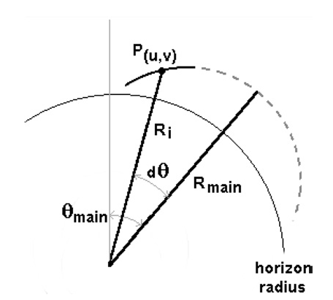
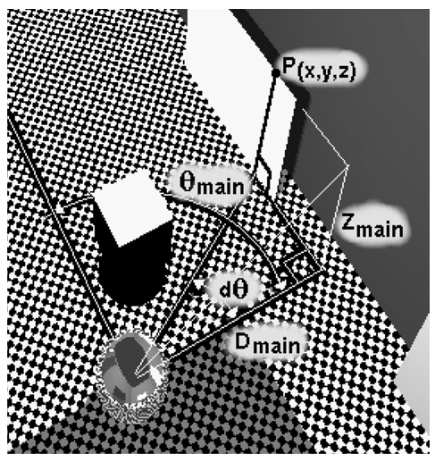
Panoramic Hough Transform – horizontal projection lines
The relative position of a scene point P(x,y, z) to the camera can be expressed as lying along a horizontal line whose closest approach to the camera axis occurs at a direction of Ɵmain.
Representation of P(x,y, z) in Ɵ_{main}, d_{Ɵ}, D_{main}, Z_{main} has one dimension of freedom representing the family of horizontal lines P(x,y, z) belong to.
R_{main} is a function of D_{main} and Z_{main} (loss of depth information).
Point P represented by an angle d_{Ɵ} along
horizontal line defined by Ɵ_{main}, D_{main} and _{main}
(b) Point P (x,y,z) when represented on an image
plane as P (u,v)

Slide 21
Panoramic Hough Transform – horizontal projection lines (contd.)
R_{main} and Ɵ_{main} are the X and Y axis of the Panoramic Hough (PH) Transform parameter space.
A single source image point maps to a loci of transform space points corresponding to the family of horizontal line projections which it may belong to.
Conversely, one point in the parameter space corresponds to a the curved family of points in the image space that a horizontal line projects to.
PH Transform used for feature extraction within an image:
(R_{main}, Ɵ_{main}) is calculated for range (-Π/2 < dƟ < Π/2).
If Ɵ_{main} is expected to lie within the bounded range Ɵ_{min} - Ɵ_{max}:
(R_{main}, Ɵ_{main}) is calculated and plotted for points where Ɵ_{min} < Ɵ_{i} + d_{Ɵ} < Ɵ_{max}.

Slide 22
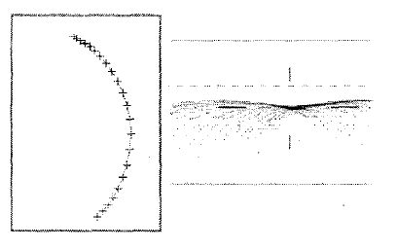
Panoramic Hough Transform – horizontal projection lines (contd.)
A set of selected image plane points are determined and for each source point, the curved loci of points (R_{main}, Ɵ_{main}) is plotted in the parameter space.
The magnitude of value added to these mapped points – Unity or proportional to edge strength.
After aggregation, transformed image searched for peaks. If peaks are detected, then the set of input points will fit the projection of a horizontal line.

Slide 23
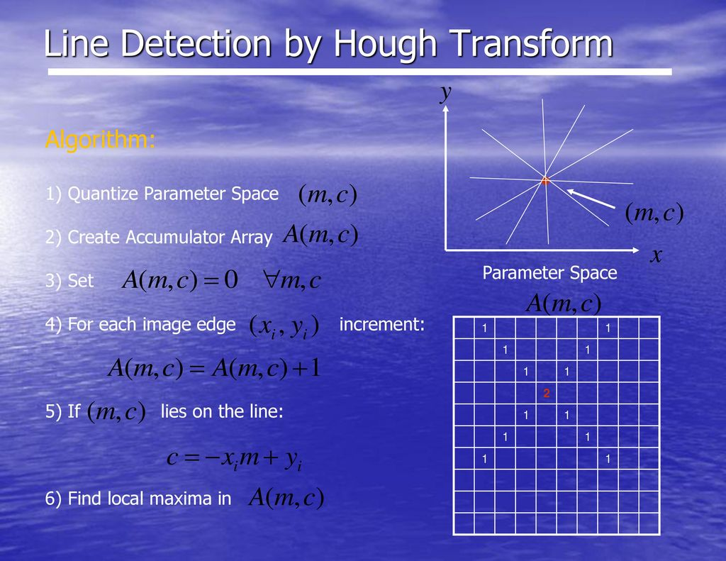
Panoramic Hough Transform
Finding projections of horizontal lines in panoramic imagery: panoramic Hough transform
Hough transform method finds straight lines by recognizing peaks in a parameter space, with each peak representing a possible line in the image
Straight line in a 2D image has two degrees of freedom, so the set of all possible lines can be represented in a 2D parameter space
Panoramic Hough Transform suffers from the below problems:
(1) only reporting the likelihood of features with some uncertainty,
(2) not completely characterizing these features,
(3) processing burden,
(4) problems with how to find local cluster peaks in the parameter space.
Above problems is addressed by using Identify and remove algorithm, Hypothesize and Verify methodology and Cluster connectivity verification.

Slide 24
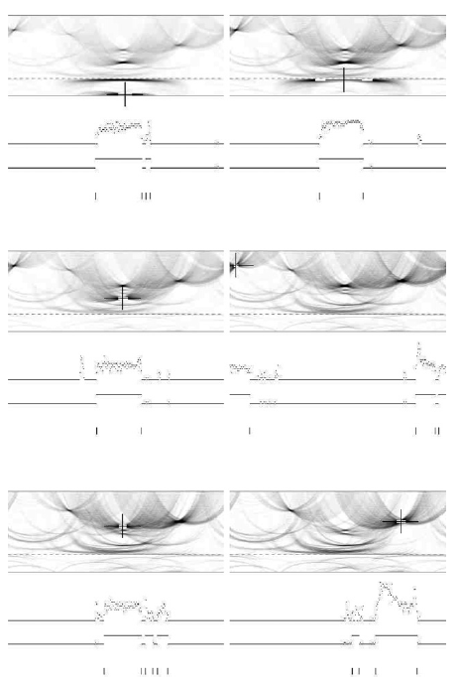
ROBUST HOUGH TRANSFORM
The image captured by the panoramic image sensor is edge-detected.
The angle of the edge (relative to the radial line) causes the edge pixel to be sent to one of four processing subroutines.
Either a 2D Hough transform to detect the curved loci of horizontal lines is performed, or a 2D histogram to find straight radial lines is executed.
Clusters are located in these four spaces and feature lines are extracted.
Successive stages of the Identify and Remove cluster detection algorithm (top-left to bottom-right). The maximum value in the PH transform image defines a cluster center marked by the crosshair, from which the width and height (marked by a black bounding box) are determined. All source image pixels whose projections fall in this bounding box are identified and their projections removed for the next iteration. Below the PH image is the raw and processed histogram of edge pixel frequency according to angular position. At the bottom of each image is the determined start and end point of that line segment(s) according to azimuth angle h, shown as vertical bars.

Slide 25
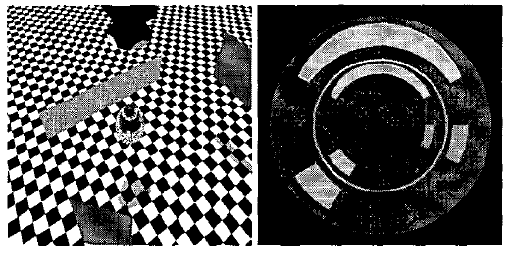
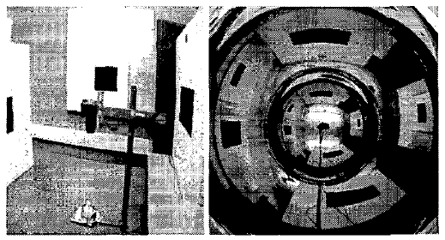
Experimentation Results
Synthetic images were generated using ray-tracing techniques, simulating the projection of vertical rectangular polygons onto the image plane of a non-SVP catadioptric panoramic camera (a).
The captured image is shows the two annular regions, one from the reflection of each mirror lobe can be seen (b).
Space does not permit a derivation of accuracy issues,
but the reconstructed vertex points were found to be within
the error predicted by the image resolution and accuracy of
feature detection
Real imagery was captured with a Canon D-30 high resolution digital camera, a 50mm lens and a double lobed spherical mirror.
The camera and setup and a sample image it captures can be seen
(a) Experimental setup (b) Sample image captured by stereo panoramic
sensor.

Slide 26
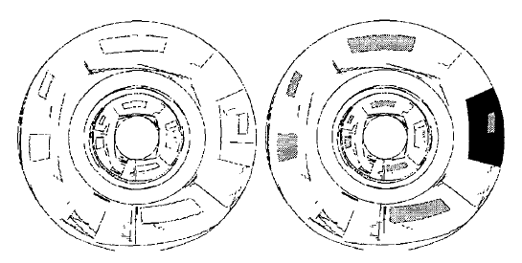
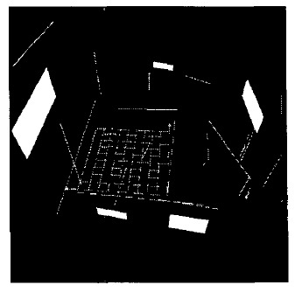
Experimentation Results (contd.)
Below are the output results shown for Line and polygon detection using the PH Transform method and the Reconstructed model respectively.

Slide 27
Panoramic 3d reconstruction using the Projection of Patterns
Implementation of a 3D reconstruction system capable of reconstructing a 360-degree scene with a single acquisition using a projection of patterns.
The system is formed by two modules:
CCD camera with a parabolic mirror that allows the acquisition of catadioptric images.
Light projector and a parabolic mirror that is used to generate the pattern projections over the object that will be reconstructed.

Slide 28
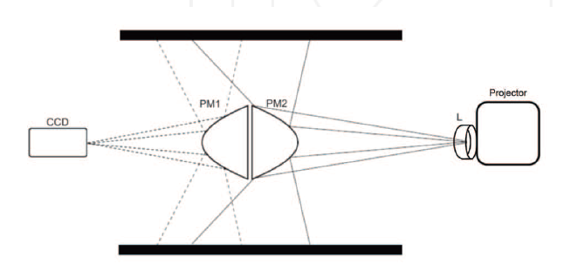
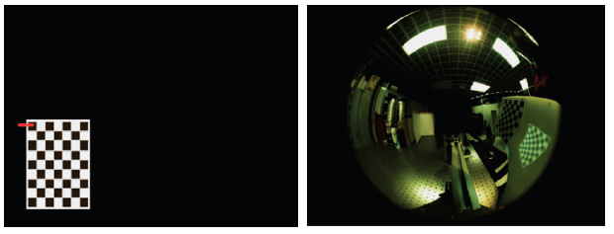
Setup and implementation
First, a catadioptric camera was assembled, aligning the mirror (PM1) with the CCD camera in order to capture the full environment that is projected onto the mirror.
The catadioptric camera obtaining the intrinsic and extrinsic parameters was calibrated using a chessboard pattern.
Once the camera is calibrated, the optical setup of the pattern projection system, placing the mirrors (PM1, PM2) back-to-back was designed.
Image on the right shows Projected calibration pattern and Image captured by the catadioptric camera showing two calibration patterns in a white plane: the printed pattern is used to calibrate the catadioptric camera (camera CCD-PM1 mirror), and the projected pattern is used to calibrate the projection system (PM2 mirror-projector).
This is followed by calibration of the catadioptric camera with the light projection system and setting a relationship between the camera positions through an epi-polar geometry for panorama based cameras.

Slide 29
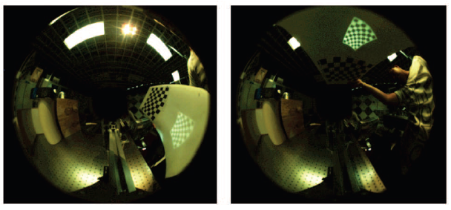
Results
Twenty-six images were used to calibrate the catadioptric camera. Each image contains a white plane with the two calibration patterns in different positions and orientations.
The PM1 and PM2 mirrors are carefully observed while trying to setup a 3D reconstruction and at times like this, there could be certain small misalignments and to address this, the calibration error is calculated for these PM1 and PM2 cameras.
Post this, Reconstruction of the object was tried and tested using two perpendicular planes measured
using the Mitutoyo BJ1015 Coordinate-measuring machine and Metrolog XG® software

Slide 30
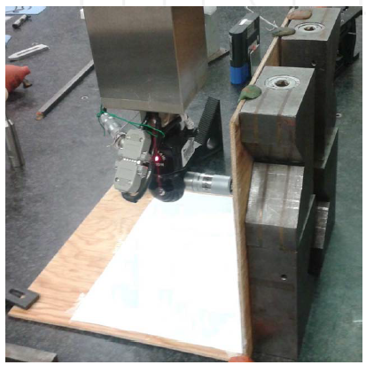
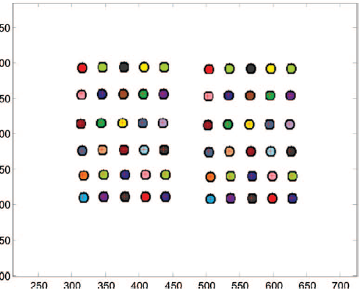
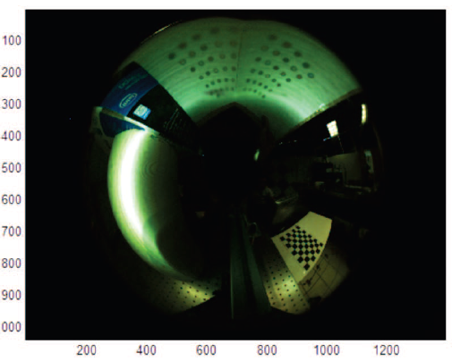
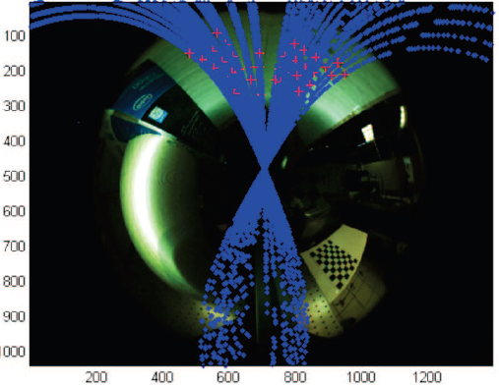
Results (contd.)
To perform the reconstruction, the pattern of points is projected onto the perpendicular planes (a), and then the image is acquired this projection using the catadioptric camera (b).
The projected pattern points have random colors. This is performed by the correspondence between the acquired image and the projected image using the colour of the projected points and the epi-polar curves constraints (c).
Once the correspondence is found, we build the 3D reconstruction of the object.

Slide 31
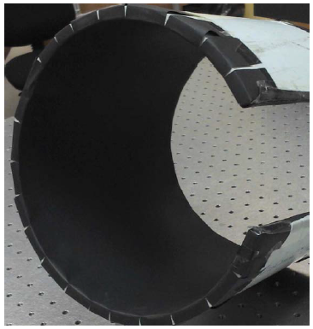
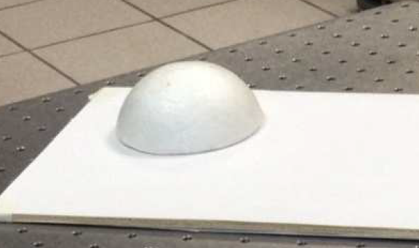
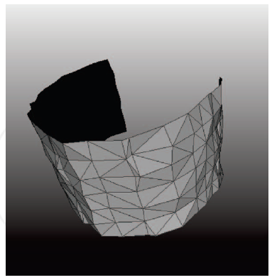
Results (contd.)
Cylindrical object - A section of a
plastic tube was used to test the functionality of the system with
curved-shape objects.
Semi-sphere used to test the functionality
3D reconstruction of the plastic tube

Slide 32
Photorealistic Scene Reconstruction by Voxel Coloring
Shape identification to colored voxel identification.
Method
Voxel division
Assign colors to voxels using color invariance
Align consistent voxels along epi-polar lines
Matching the voxels, followed by neighborhood matching

Slide 33
Photorealistic Scene Reconstruction by Voxel Coloring
Advantages
The cameras can be apart, with large visibility changes (in color, texture, illumination)
Consistent matching until completely occluded
Disadvantages
Precise calibration
Smaller voxel sampling -> more prone to calibration error

Slide 34
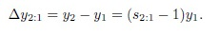
Stereo Reconstruction from Multiperspective Panoramas
In traditional methods, camera moves in horizontal line, but real word objects move with different perspectives.
Method
Thus, we make camera move in concentric circles.
Features are not present in epi-polar lines.
Selecting matching columns.
Parallax effect due to depth disparity.
Depth maps are used and the disparity in depth map is given by the formula above.
After detection, matching is done by cylinder sweep algorithm.
In plane sweep, match window along epi-polar lines
In cylinder sweep, perform horizontal translation and vertical scaling with respect to radii r.

Slide 35
Stereo Reconstruction from Multiperspective Panoramas
Advantages
Effective for multi-prespective image stitching.
Flexibility of cylinder-sweep algorithm.
Disadvantages
Expensive depth map calculation.

Slide 36
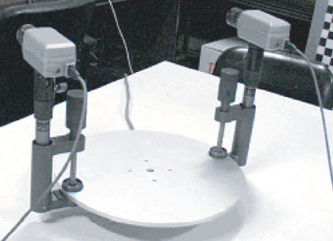
Panoramic 3D Reconstruction Using Rotational Stereo Camera with Simple Epipolar Constraints
2 stereo cameras (static and non-rotating) placed on a horizontally circular path.
Each camera has 2 slits each.

Slide 37
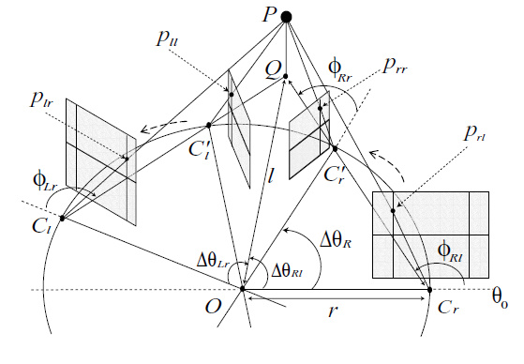
Panoramic 3D Reconstruction Using Rotational Stereo Camera with Simple Epipolar Constraints
Camera is calibrated with varying horizontal disparity but same vertical angle
Method
Concept : Accuracy depends on the horizontal FOV.
Epipolar constraints:
Restraint to horizontal line (row) for Rl and Lr
Restraint to vertical line (column) for Rl and Rr
both vertical and horionzal axis for Rl and Ll
Sum of Squared Differences (SSD) from constraints
Depth map for SSD minimization
Averaging noise and ambiguity reduction

Slide 38
Panoramic 3D Reconstruction Using Rotational Stereo Camera with Simple Epipolar Constraints
Advantages
Reference points from 4 images, leads to higher accuracy of the calculated depth map.
Disadvantages
Tripled computational cost

Slide 39
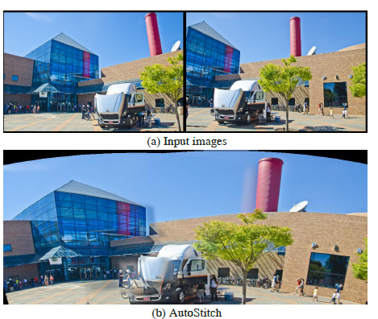
Parallax-tolerant Image Stitching
Parallax :
Difference between the image (position of objects) as seen by a 2 viewpoints.
For homography, (images from same viewpoint), there is roughly no parallax, and the scene is epi-polar aligned.
Parallax is unavoidable for multi-prespective images.
Method
Perfect alignment can cause curving effect.

Slide 40
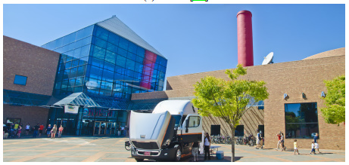
Parallax-tolerant Image Stitching
Method
SIFT for feature detection.
Randomly select seed feature.
Incremental grouping of neighboring feature points over threshold.
Value for each feature point based on the iteration process.
Seam cutting for non-aligned parts.

Slide 41
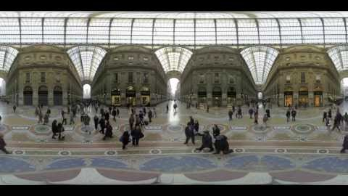
Parallax-tolerant Image Stitching
Advantages
Seem-less distortion.
Disadvantages
Cannot work for very large parallax (very less common features)

Slide 42


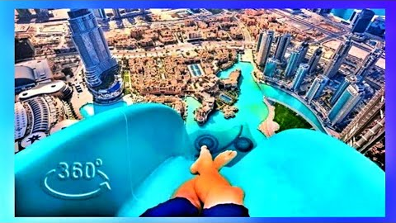
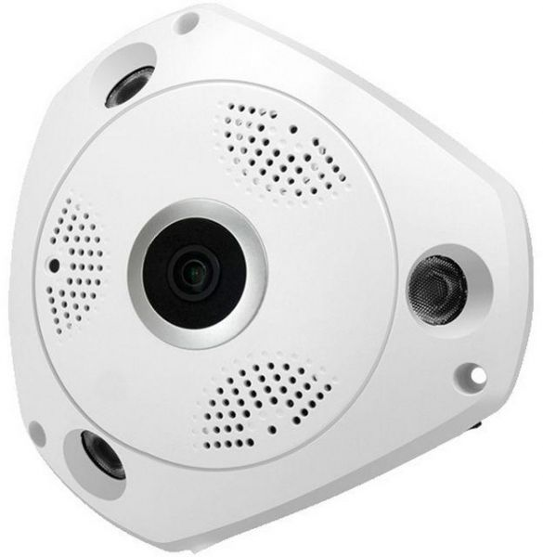
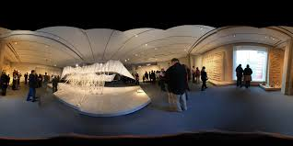


Practical applications
Photography
Virtual Reality
Cinema/Motion Films
Perception/Scene Replication/Scene Tear Down

Slide 43


Way forward
Motion Parallax – an important depth cue needed to explore static scenes with translation as well as rotation. Existing cameras projection techniques flatten the panorama and remove motion parallax.
2D to stereo conversion, using CNNs or GAN, convert a 2D panorama to a stereoscopic pair. GAN architecture to add the selection layer on the generator and introduce the “pseudo” depth peeling loss term, generating concentric mosaics (CMs) instead of creating another panorama with shifted views.

Slide 44

references
Panoramic stereo reconstruction using non-SVP optics, Mark Fiala, Anup Basu, Department of Computing Science, University of Alberta, 2002, Computer Vision and Image Understanding.
Panoramic Stereo, David Southwell, Anup Basu, Mark Fiala and Jereome Reyda, ICPR, 1996
Panoramic 3D Reconstruction Using Rotational Stereo CamerA with Simple Epipolar Constraints, Wei Jiang, Masatoshi Okutomi, Shigeki Sugimoto, CVPR, 2006.
A PANORAMIC 3D Reconstruction SysteM Based on the Projection of Patterns, Diana-Margarita Córdova-Esparza, José-Joel Gonzalez-Barbosa, Juan-Bautista Hurtado-Ramos and Francisco-Javier Ornelas-Rodriguez, 2014
Automatic Panoramic Image Stitching using Invariant Features, Matthew Brown and David G. Lowe, Dept. of CS, UBC, 2007
360-Degree 3D Ground Surface Reconstruction Using a Single Rotating Camera, Kouma Motooka, Shigeki Sugimoto, Masatoshi Okutomi, Takeshi Shima, 2014

Slide 45

Thank You!
hosahall@Ualberta.ca
hharihar@ualberta.ca
umashank@ualberta.ca

